Slide 1






WebScanPro Web Application Security Testing Tool
Sudharsan S

Slide 2
Agenda
Project Overview | What is WebScanPro?
Objectives and Outcomes | What did we aim for and achieve?
Module-wise Explanation | Deep dive into each week’s work
Demo Flow & Results | Live Demonstration and Findings
Future Scope | Next step and Enhancements
Cocclusion | Final Overview and Conclusion

Slide 3
Project Overview
What is WebScanPro?
An automated security testing tool based on OWASP Top 10
Simulates real-world attacks and provides actionable insights
Integrates AI/ML for intelligent detection and reporting
Designed for educational and professional testing environments

Slide 4
Key Features
Intelligent Crawler with Session Management
SQL Injection & XSS Testing
Authentication & Session Security Testing
Access Control & IDOR Detection
AI-Powered Report Generation

Slide 5

Objectives and Outcomes
Objectives:
Automate detection of common web vulnerabilities
Provide comprehensive scanning and reporting
Integrate AI/ML for enhanced accuracy
Support OWASP Top 10 compliance testing
Outcomes Achieved:
7-week complete implementation
43+ vulnerabilities detected in DVWA
5+ ML models deployed for security insights
Professional HTML/PDF reports generated
90%+ detection accuracy with <5% false positives

Slide 6
Technology Stack
Tools & Platforms:
AI/ML Integration:
Programming & Frameworks:
Python 3.10+, BeautifulSoup4, Requests
Flask(Frontend Dashboard)
Scikit-learn, Pandas, NumPy (ML)
HTML/CSS/JavaScript (Reporting)
Docker & Docker Compose
DVWA (Damn Vulnerable Web Application)
VS Code, PowerShell
Git & GitHub
Isolation Forest, Random Forest, K-Means, DBSCAN
TF-IDF, Logistic Regression, NLP

Slide 7
Module 1: Intelligent Crawler & Target Scanning
Week 2 Implementation
Automated login and session management
Recursive page crawling with depth control
Form detection and input field analysis
URL mapping and risk assessment
Output:
target_report.html – Comprehensive scan summary
crawl_results.json – Raw data for analysis
Identified 30+ input fields with risk classification

Slide 8
Module 2: SQL Injection Testing
Week 3 Implementation
25+ SQLi payloads covering:
Union-based, Error-based, Time-based, Boolean-based
GET/POST parameter testing
DVWA-specific vulnerability detection
Automated error pattern analysis
Results:
SQLi vulnerabilities detected in DVWA
Severity classification (High/Medium/Low)
Remediation suggestions provided

Slide 9
Module 3: XSS Testing
Week 4 Implementation
20+ XSS payload variations:
Script tags, Event handlers, JavaScript URLs, SVG
Reflected XSS detection with encoding awareness
Context-aware testing for different injection points
Results:
XSS vulnerabilities detected in DVWA XSS_R/XSS_S pages
Successful script injection and event handler execution
Detailed reporting with mitigation steps

Slide 10
Module 4: Authentication & Session Security
Week 5 Implementation
Weak/default credential testing (50+ credentials)
Brute-force simulation with rate-limiting detection
Session cookie analysis (Secure, HttpOnly, SameSite)
Session fixation and hijacking testing
AI/ML Integration:
Isolation Forest for anomaly detection
Random Forest for attack pattern classification
DBSCAN for session entropy analysis
Findings:
Weak credentials detected
Missing security flags in cookies
Session fixation vulnerability identified

Slide 11
Module 5: Access Control & IDOR Testing
Week 6 Implementation
Role identification (Admin, User, Guest)
Horizontal/Vertical privilege escalation testing
Insecure Direct Object Reference (IDOR) detection
Response pattern analysis using ML
ML Models Used:
K-Means clustering for response patterns
Random Forest classifier for access violations
IDOR pattern detection with clustering
Findings:
Vertical escalation vulnerabilities
Multiple IDOR instances detected
Missing server-side authorization checks

Slide 12
Module 6: AI-Driven Report Generation
Week 7 Implementation
Result Aggregation from all modules
AI Classification using TF-IDF + Logistic Regression
Risk Scoring based on exploitability and impact
NLP-based mitigation suggestions
Interactive Dashboard with visualizations
Dashboard Features:
Executive summary with AI insights
Severity distribution charts
Top priority vulnerabilities table
OWASP compliance matrix
JSON findings explorer

Slide 13
Demo Flow

Slide 14
Live Demonstration Outline
Start DVWA Container – Docker setup
Run Target Scan – Crawling and analysis
Execute SQLi Tests – Vulnerability detection
Run XSS Tests – Cross-site scripting checks
Test Authentication – Credential and session testing
Access Control Testing – Privilege escalation checks
Generate AI Report – Comprehensive dashboard
Expected Output:
Real-time terminal logs
HTML report generation
AI dashboard with findings

Slide 15
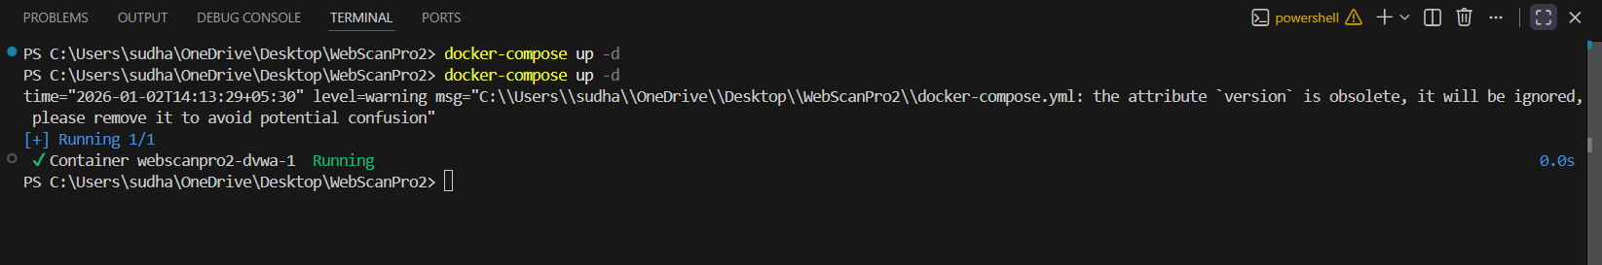
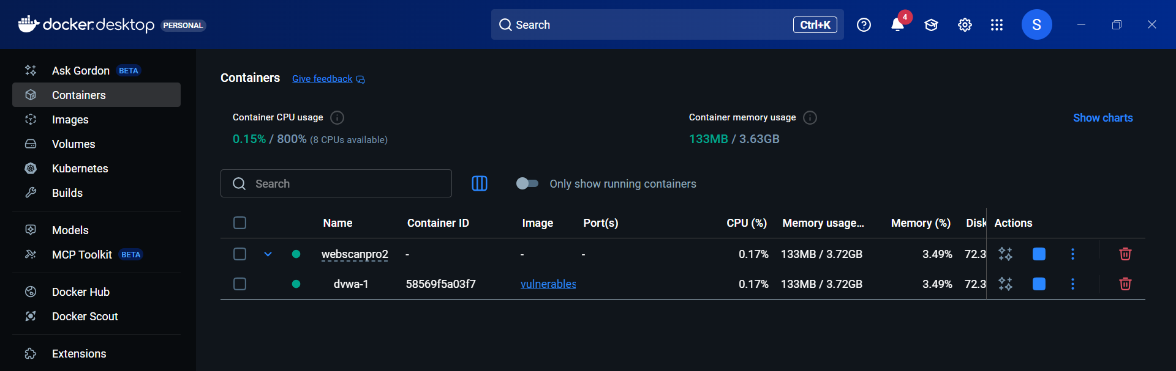
Start DVWA Container – Docker setup

Slide 16
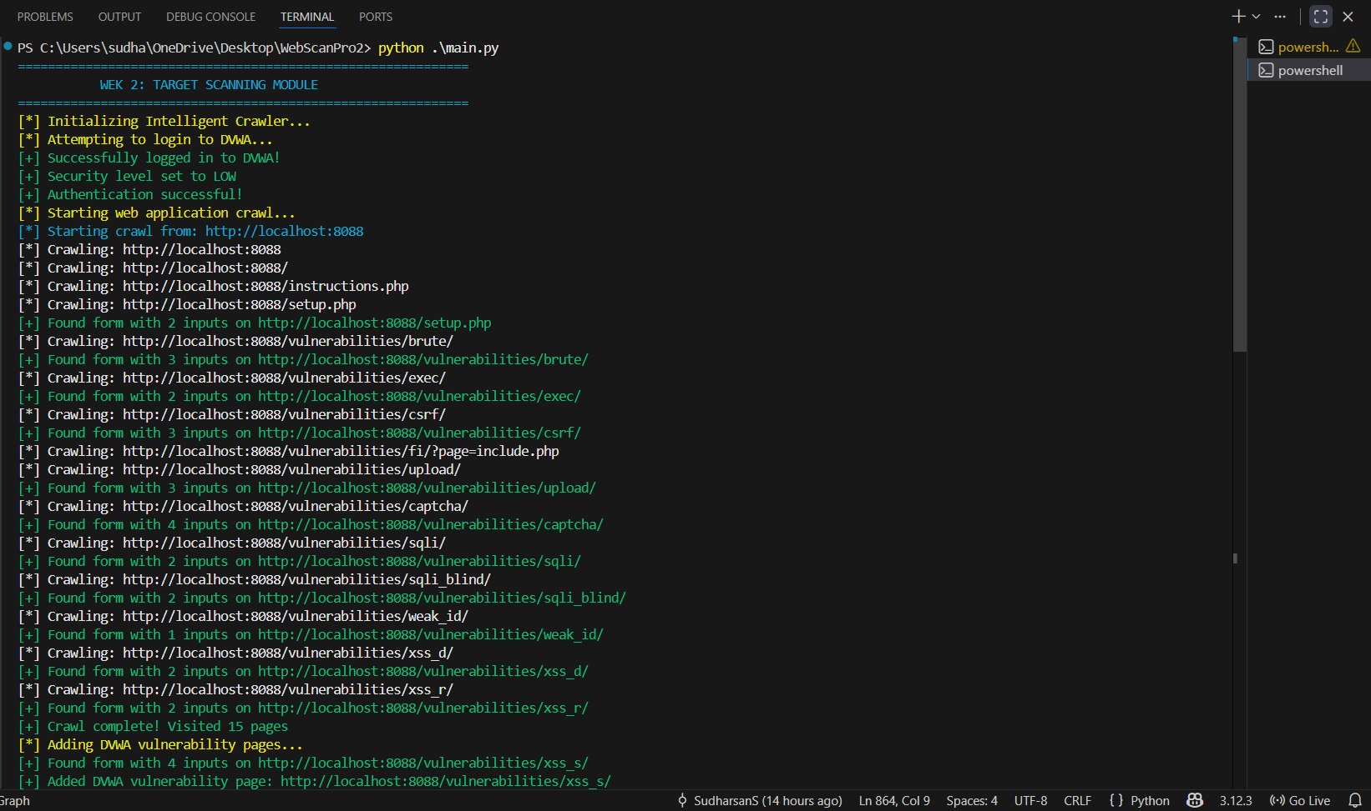
Run Target Scan – Crawling and analysis

Slide 17
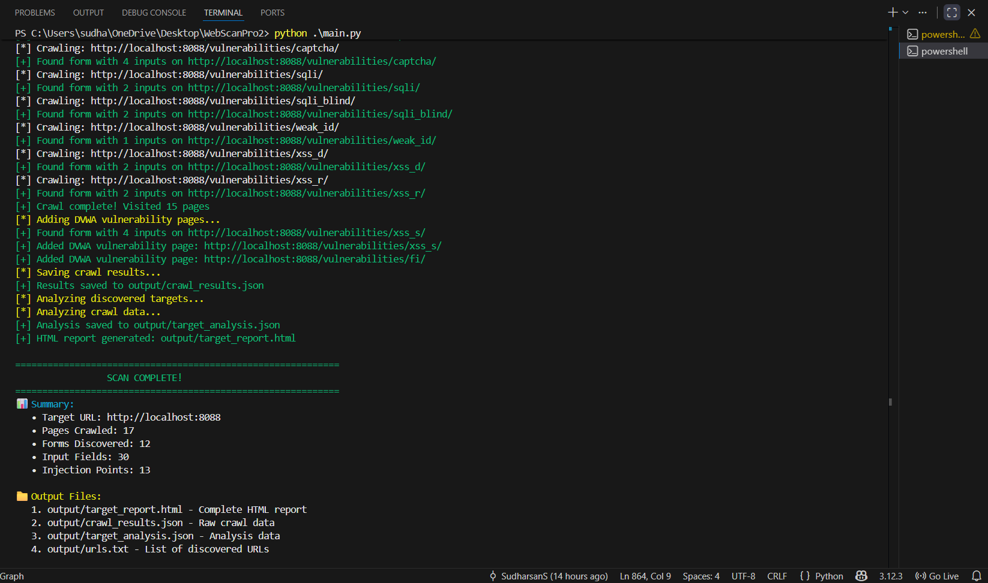

Slide 18
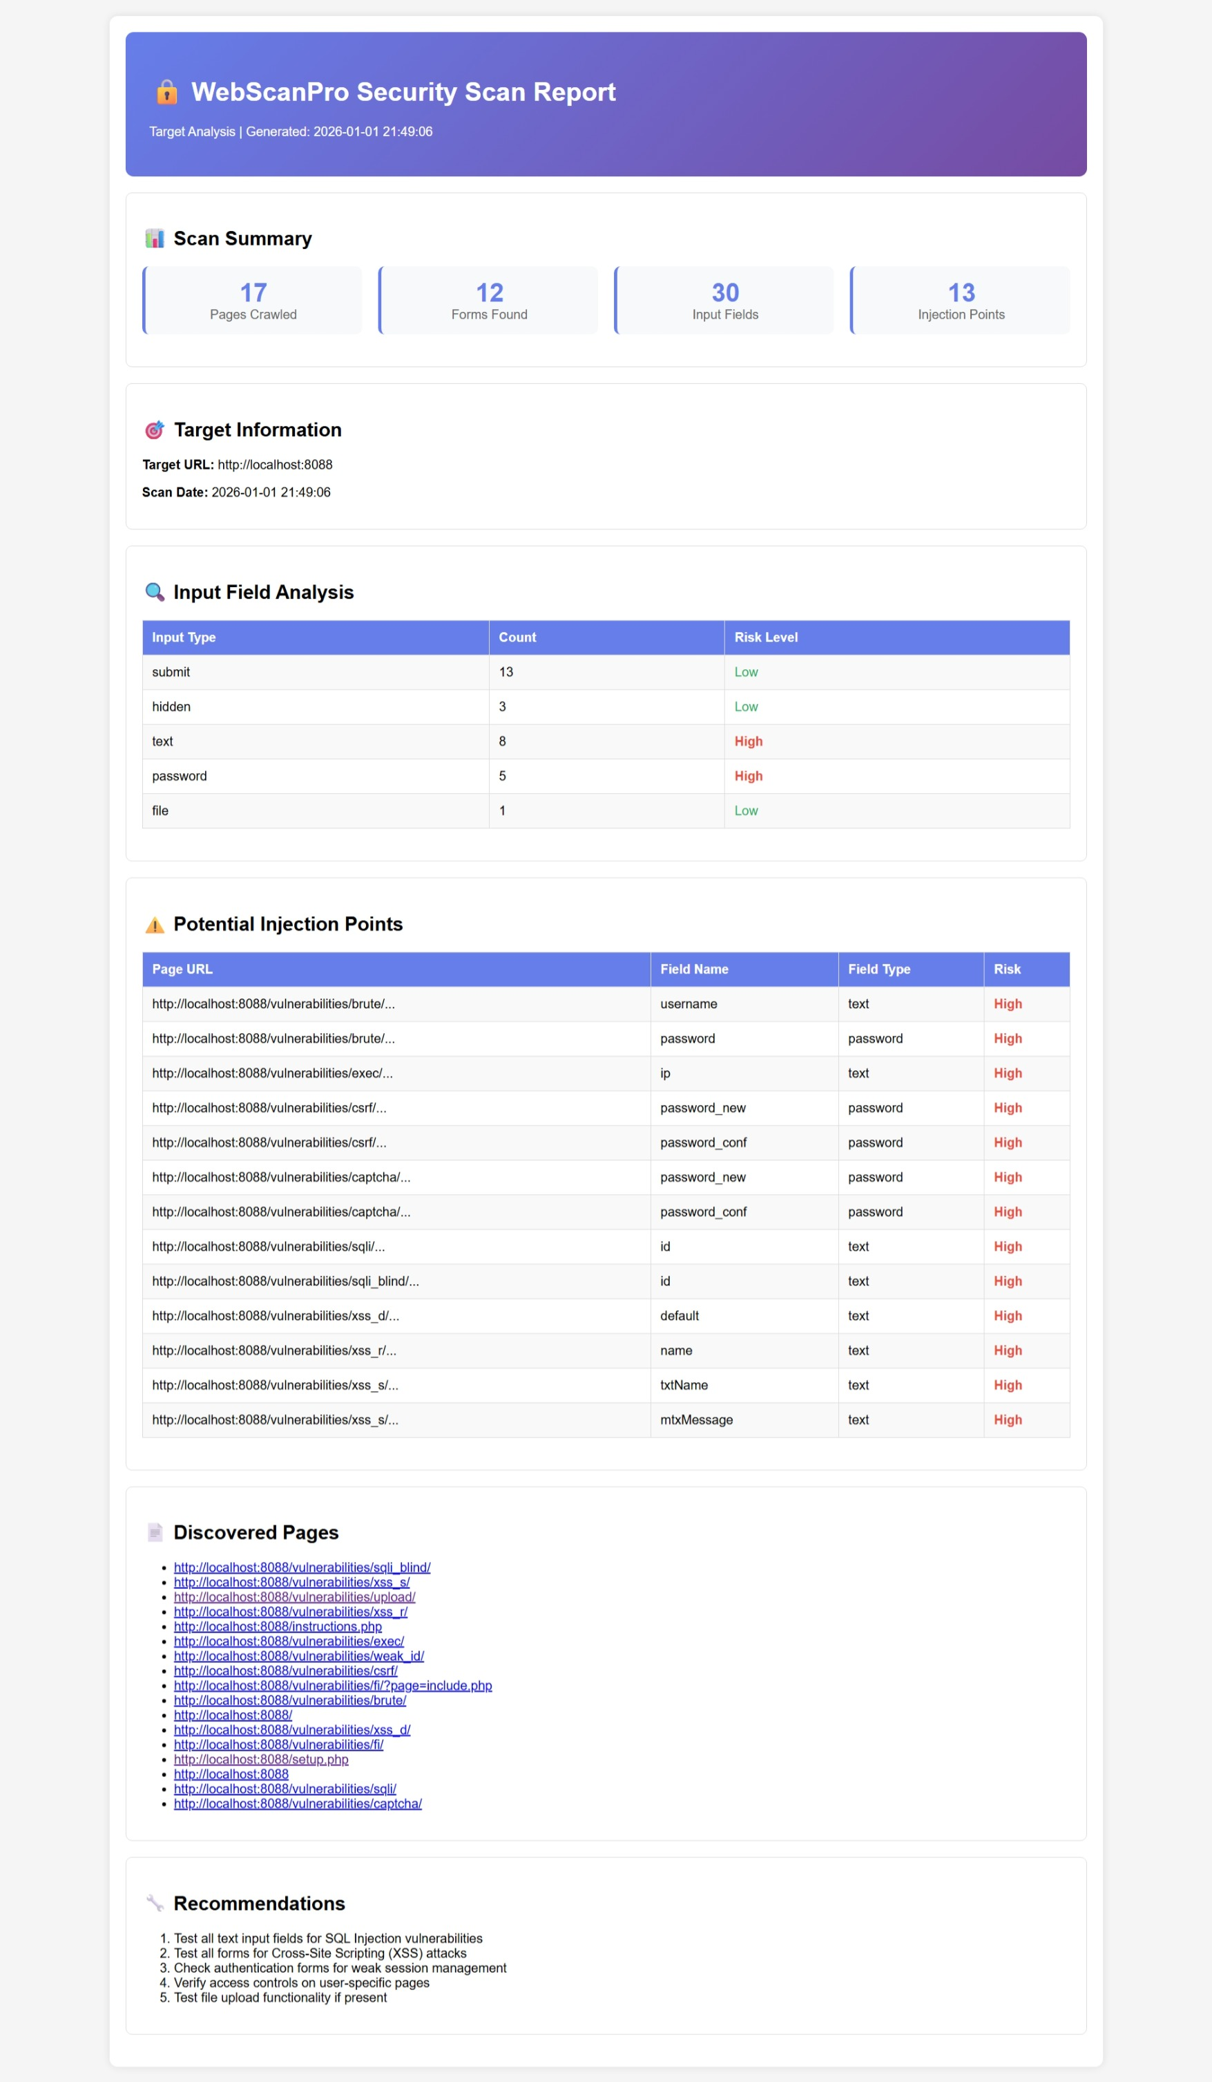
Target Scan HTML Report
Click to view JSON Output-target_analysis.json

Slide 19
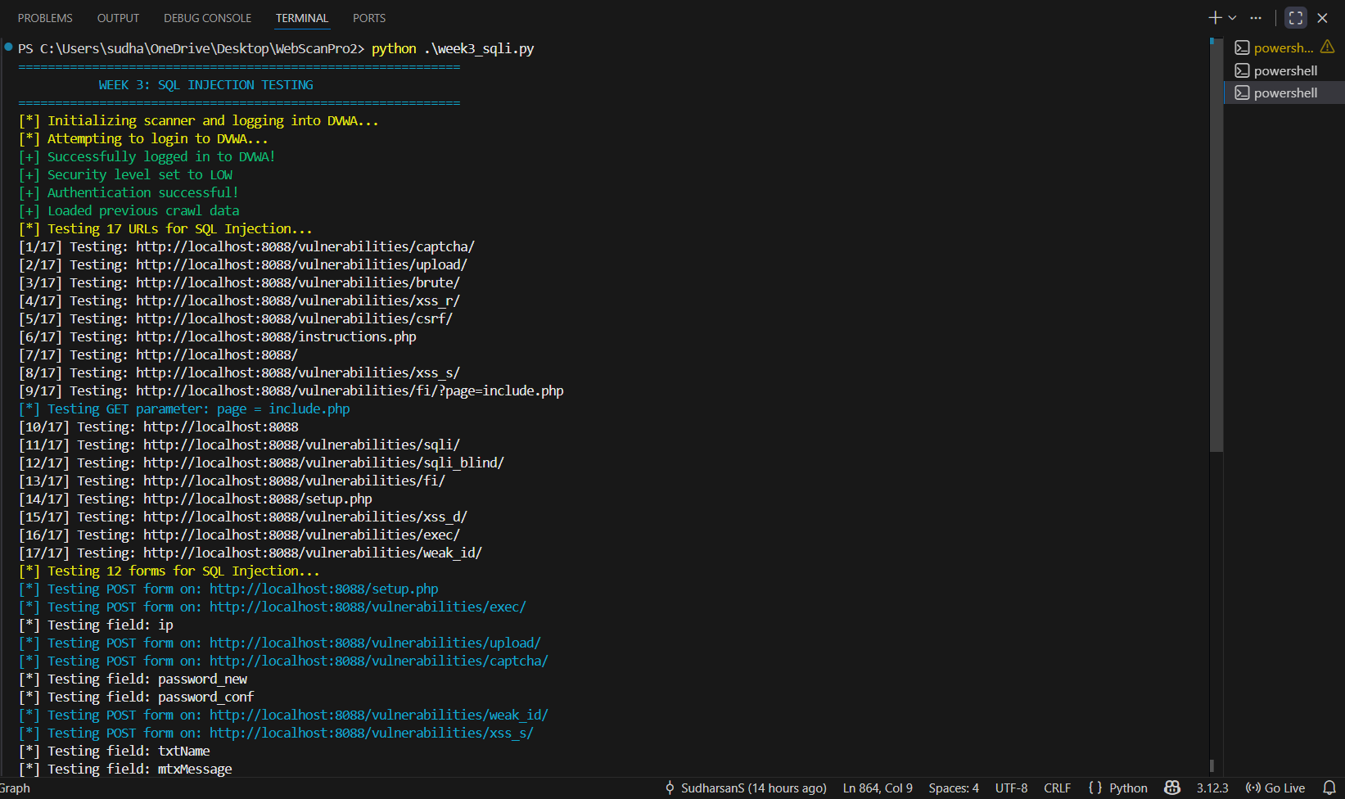
Execute SQLi Tests – Vulnerability detection

Slide 20
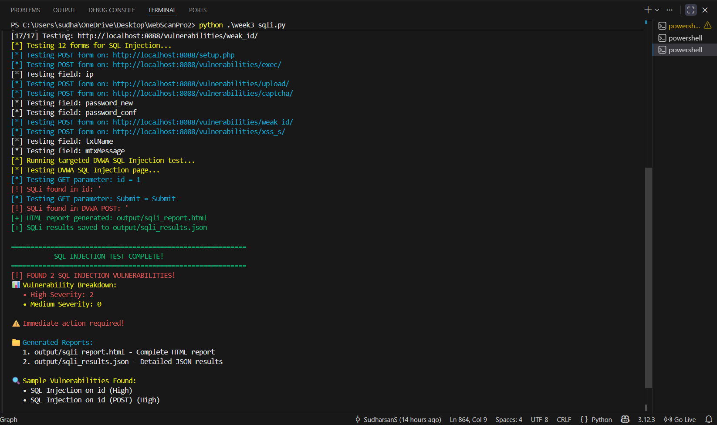

Slide 21
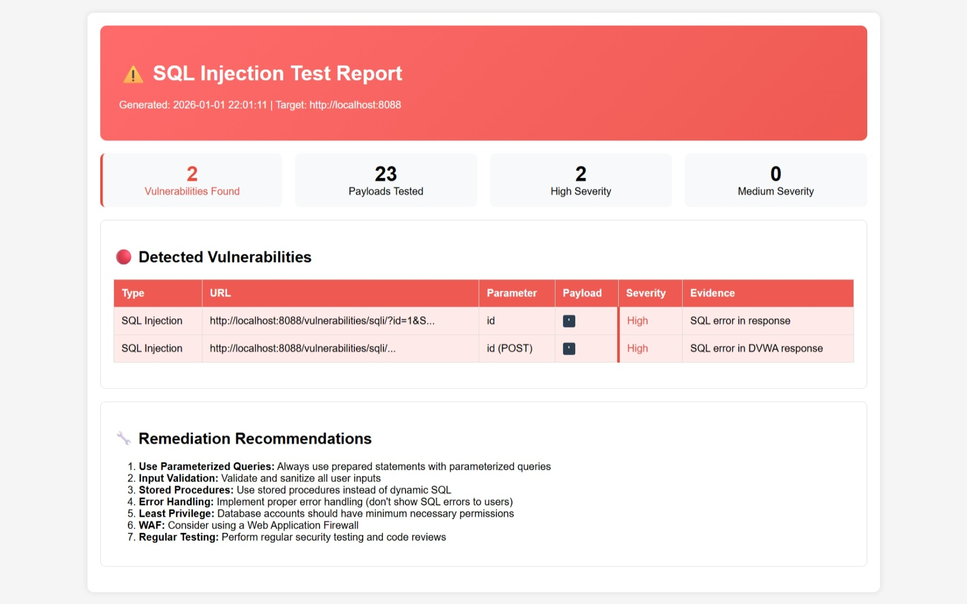
SQL Injection HTML Report
Click to view JSON Output-sqli_results.json

Slide 22
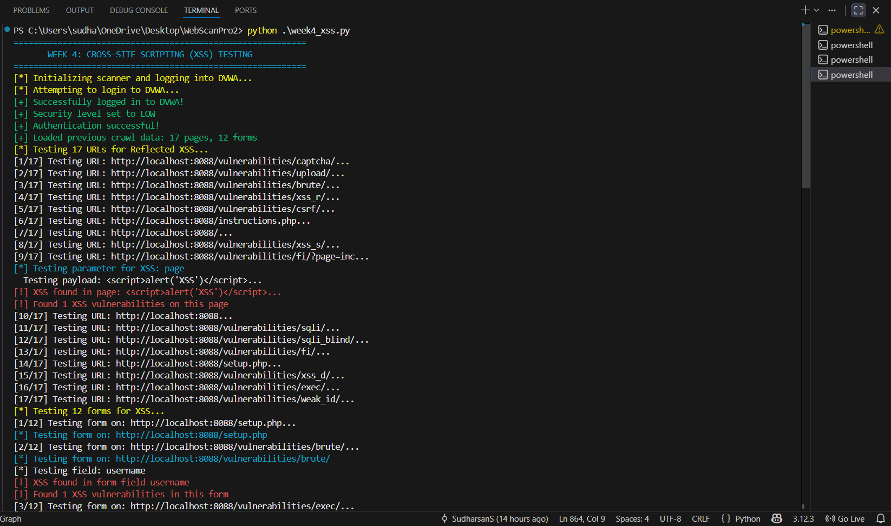
Run XSS Tests – Cross-site scripting checks

Slide 23
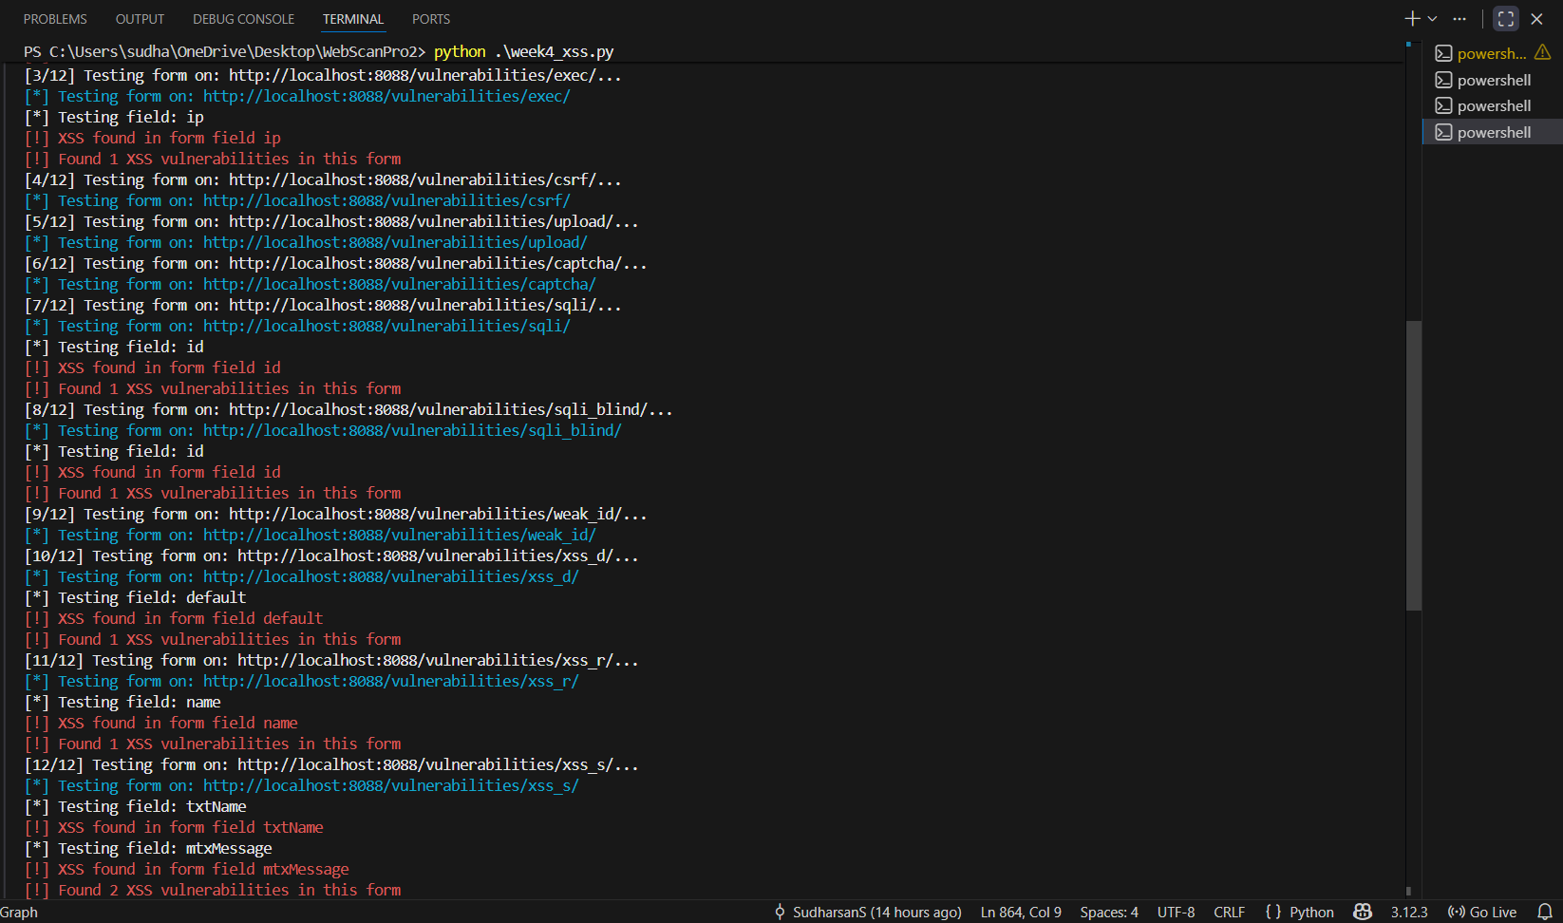

Slide 24
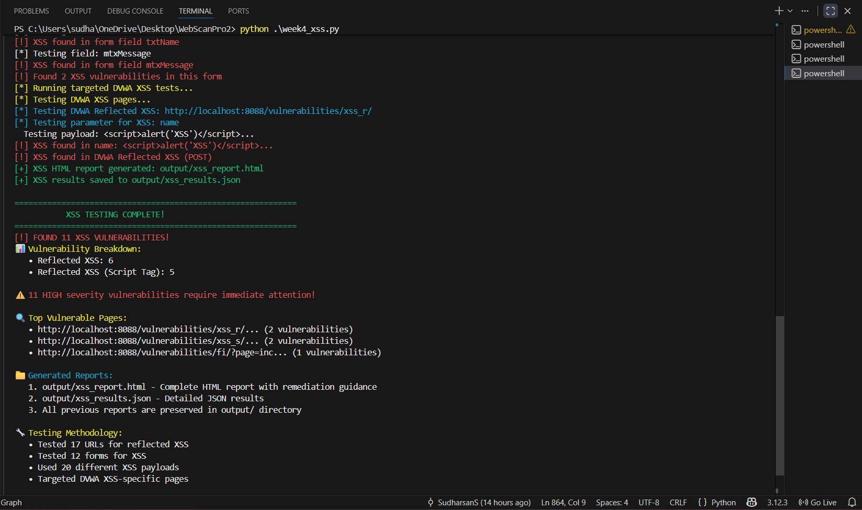

Slide 25
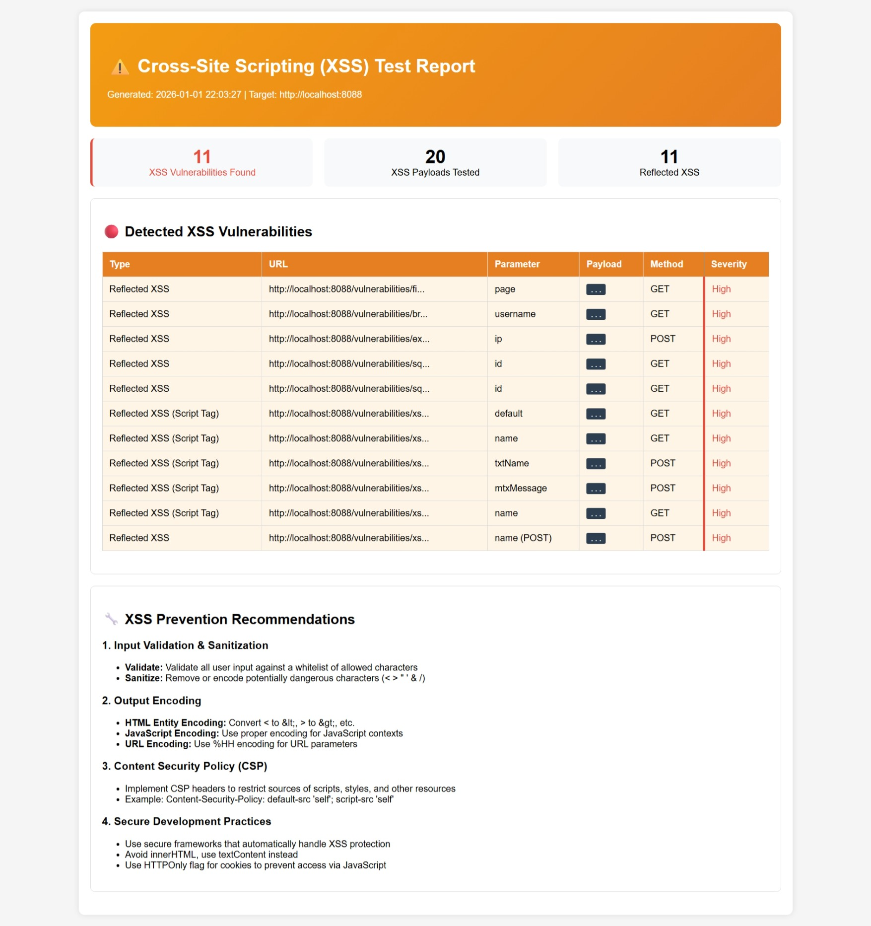
Cross-Site Scripting HTML Report
Click to view JSON Output-xss_results.json

Slide 26
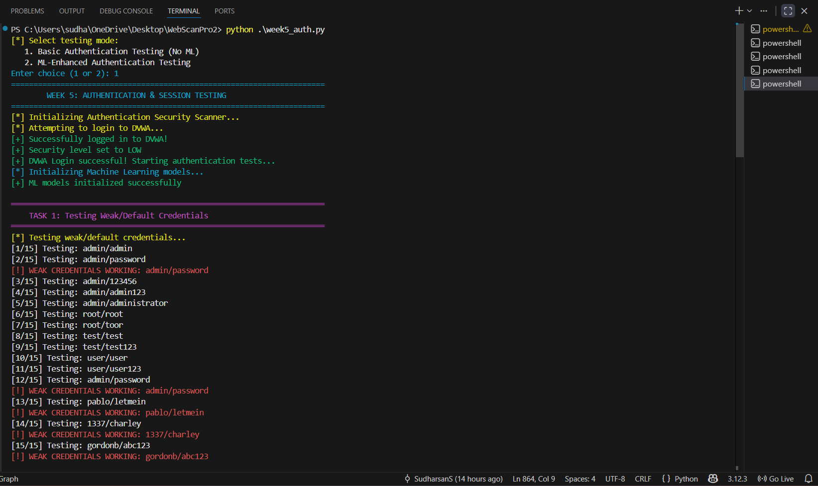
Test Authentication – Credential and session testing

Slide 27
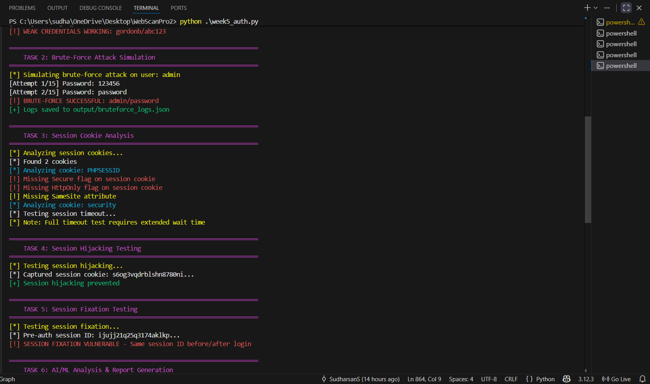

Slide 28
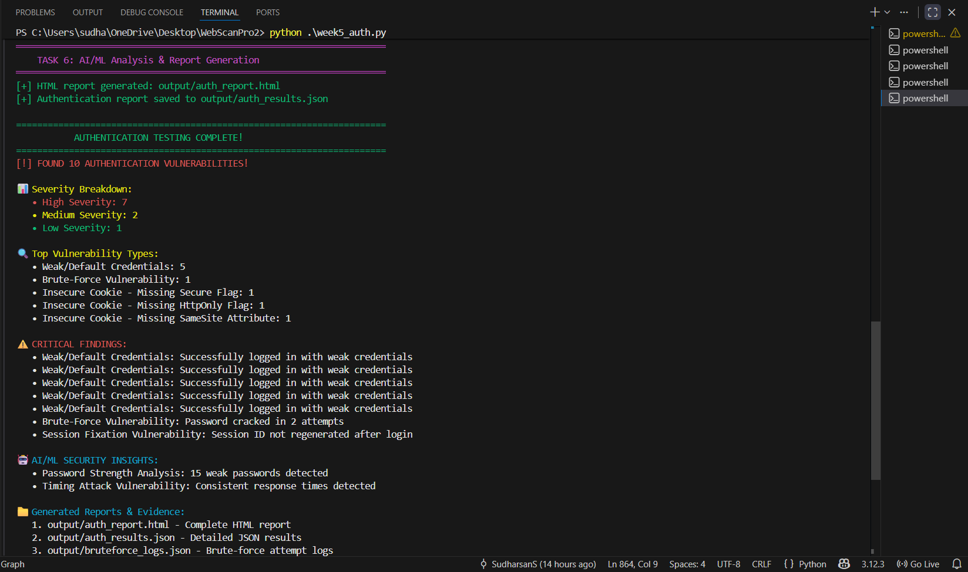

Slide 29
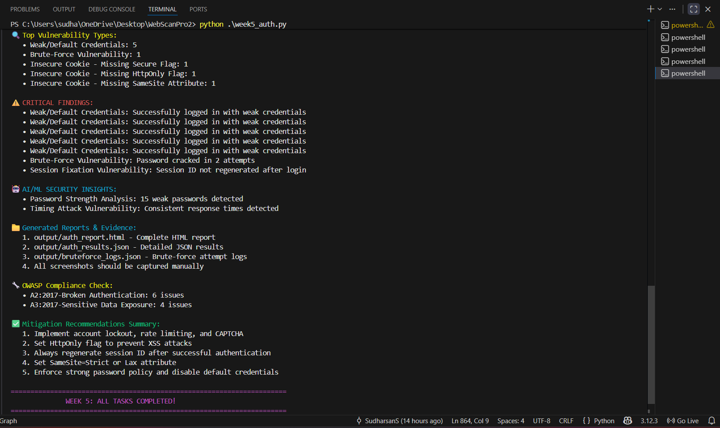

Slide 30
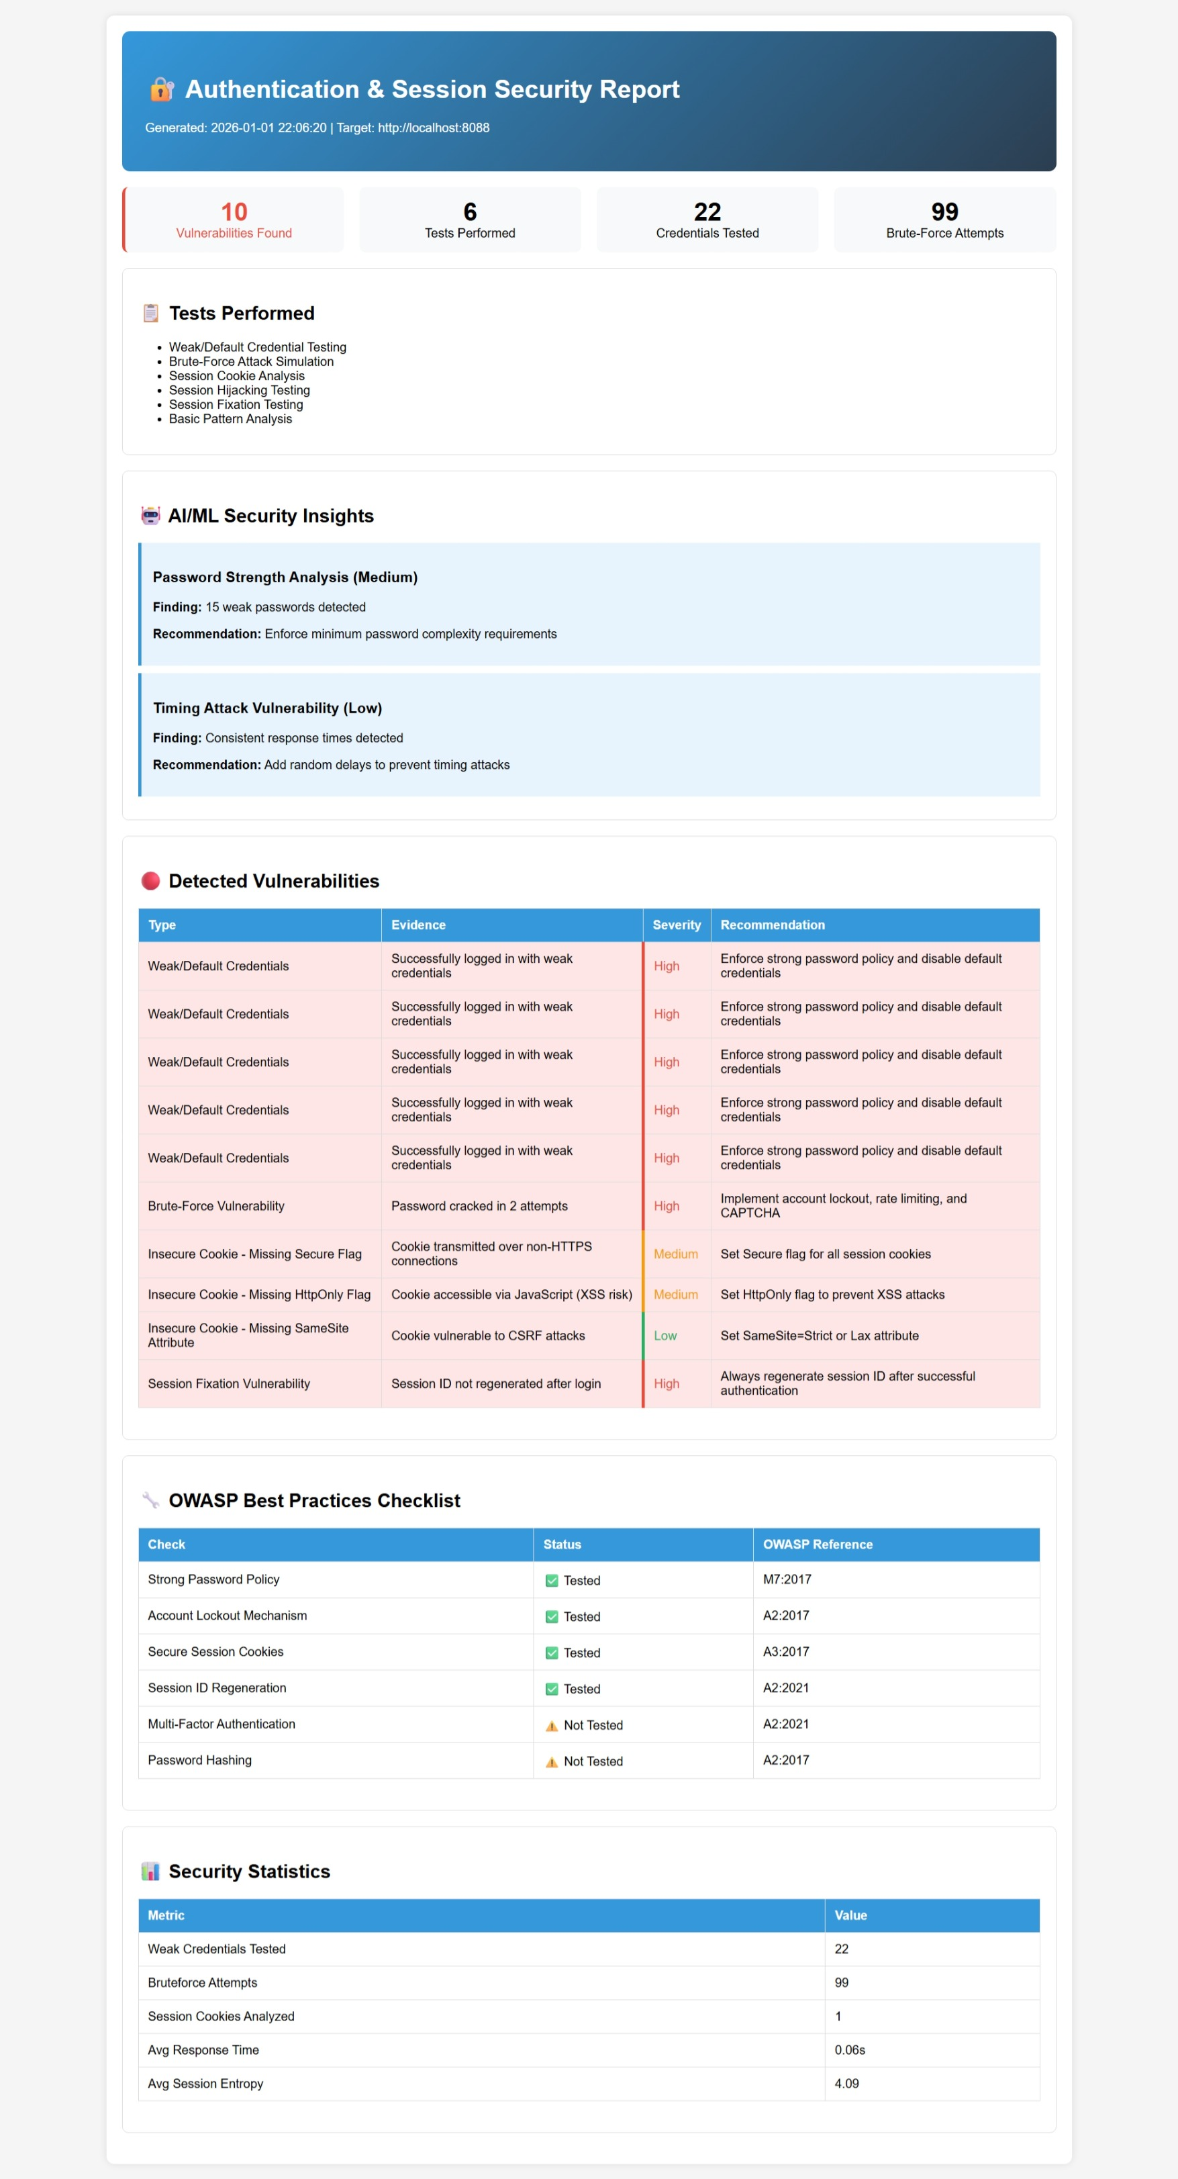
Authentication & Session Testing HTML Report
Click to view JSON Output-auth_results.json
Click to view JSON Output-bruteforce_logs.json

Slide 31
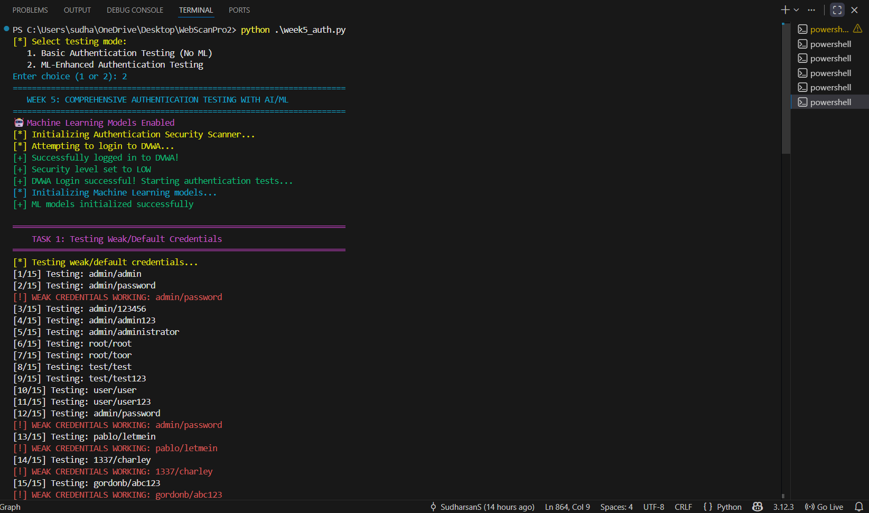
Test Authentication – Credential and session testing with ML

Slide 32
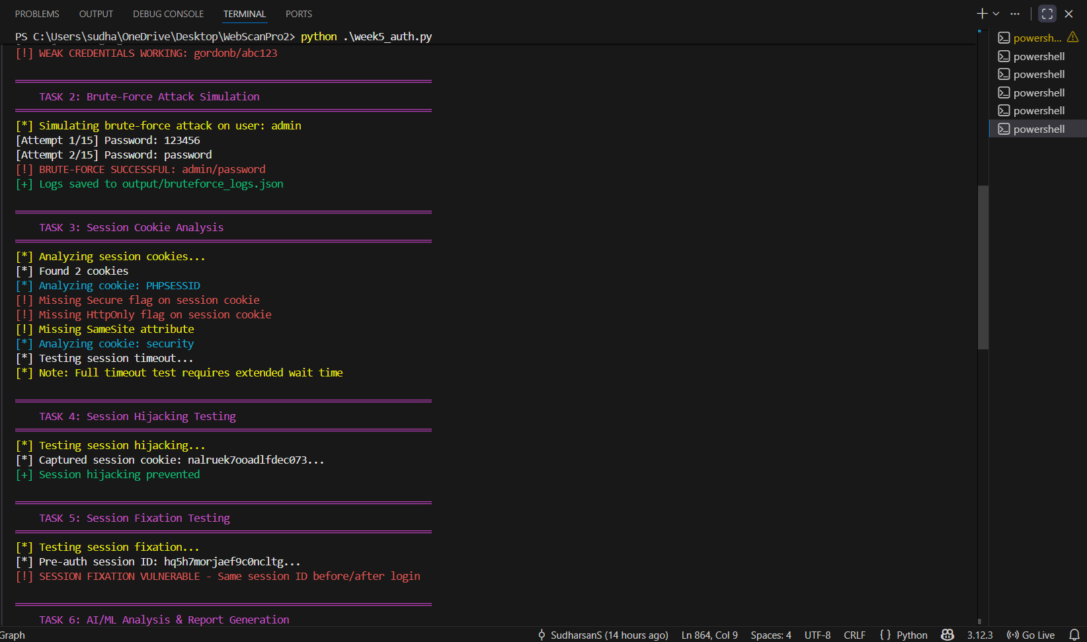

Slide 33
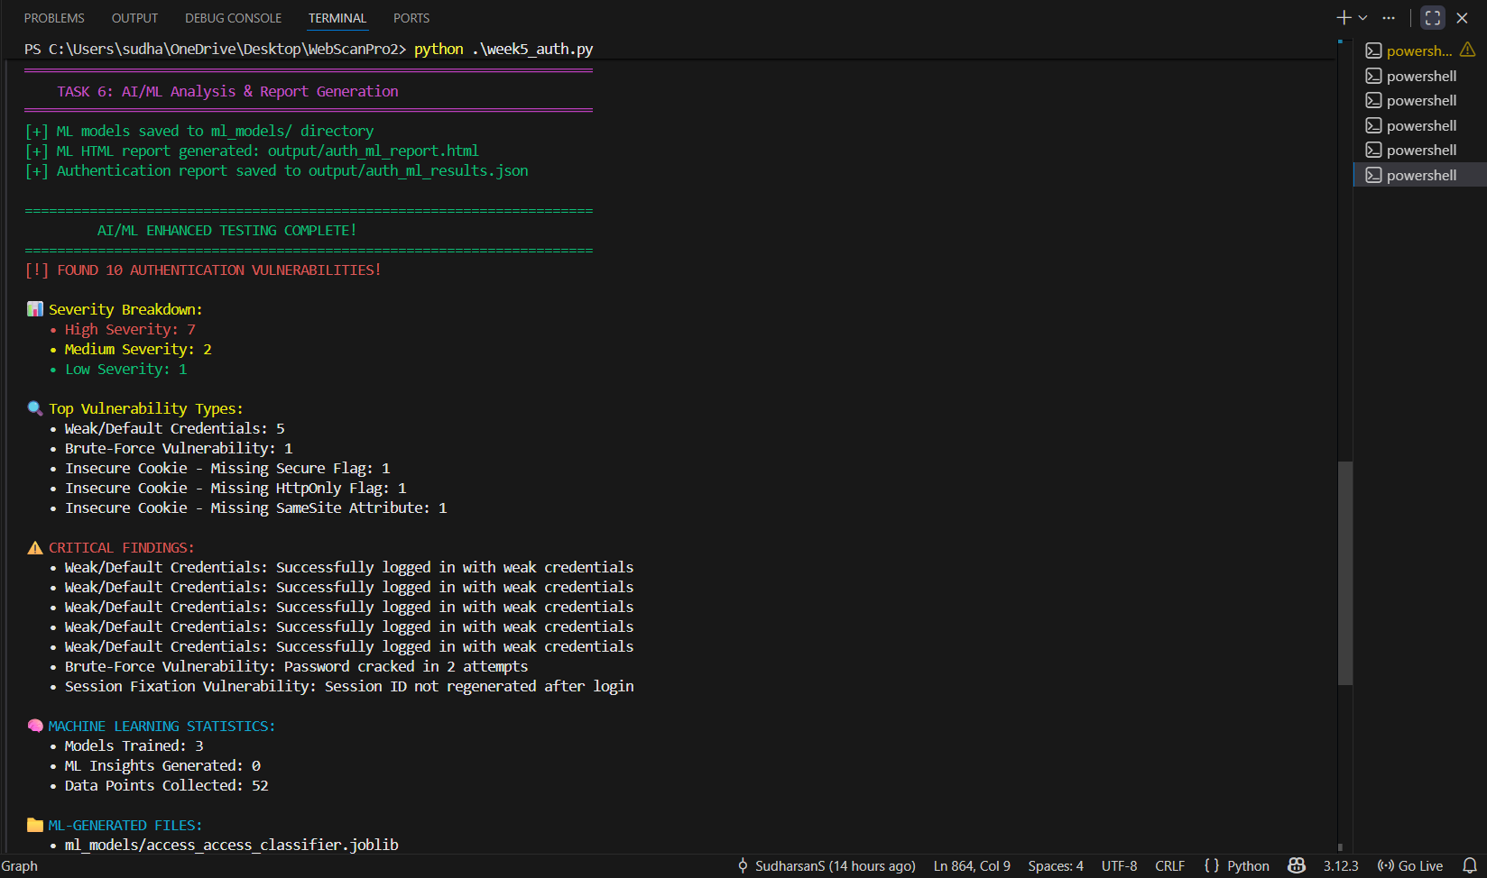

Slide 34
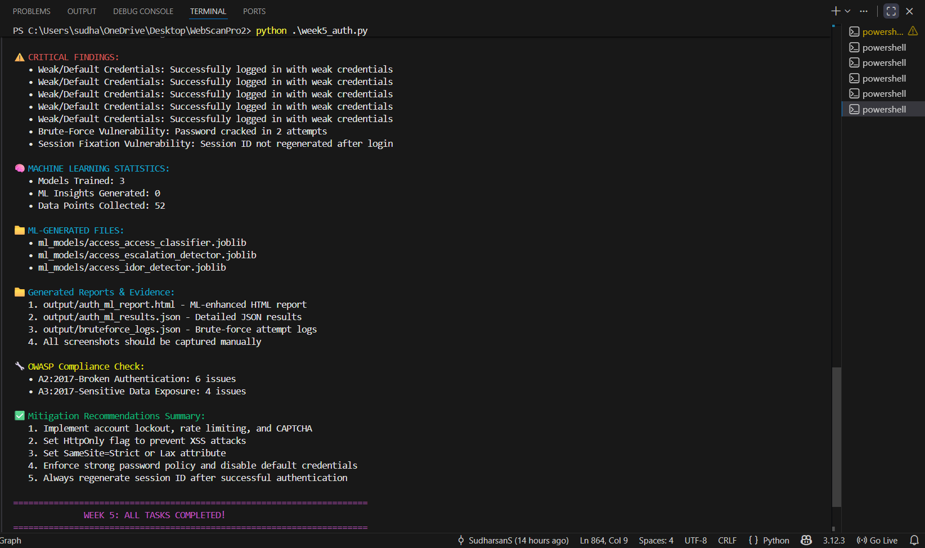

Slide 35
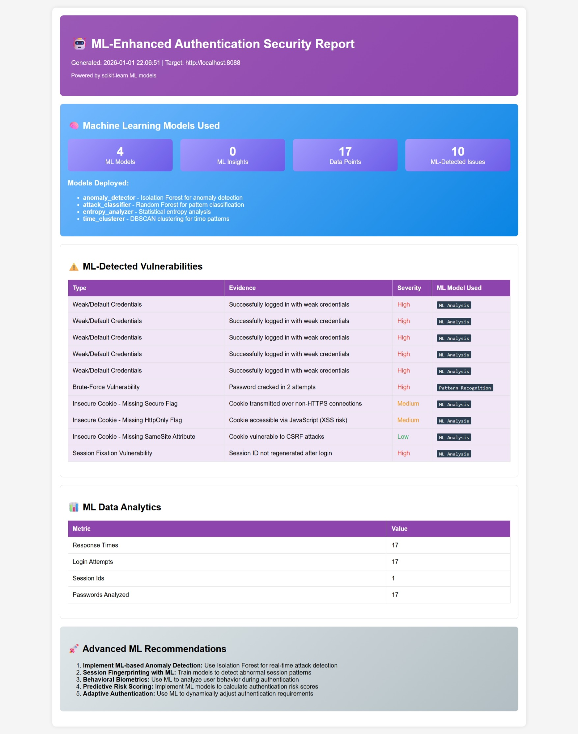
Authentication & Session Testing HTML Report with ML
Click to view JSON Output-auth_ml_results.json
Click to view JSON Output-bruteforce_logs.json

Slide 36
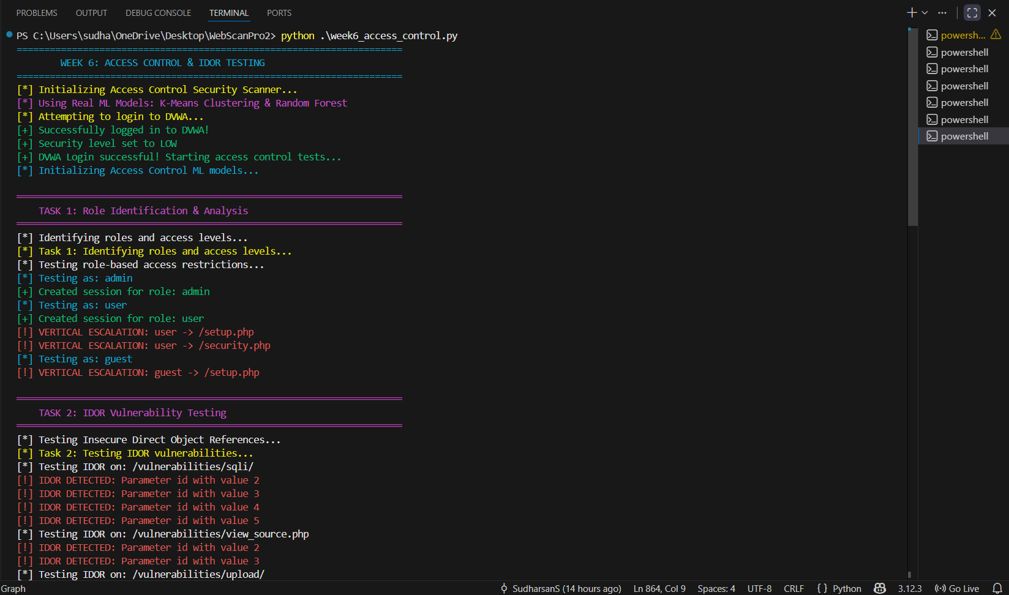
Access Control Testing – Privilege escalation checks

Slide 37
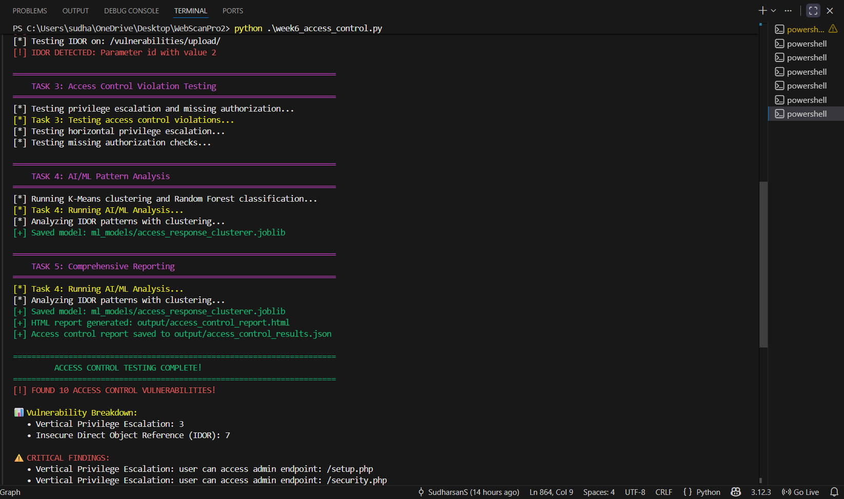

Slide 38
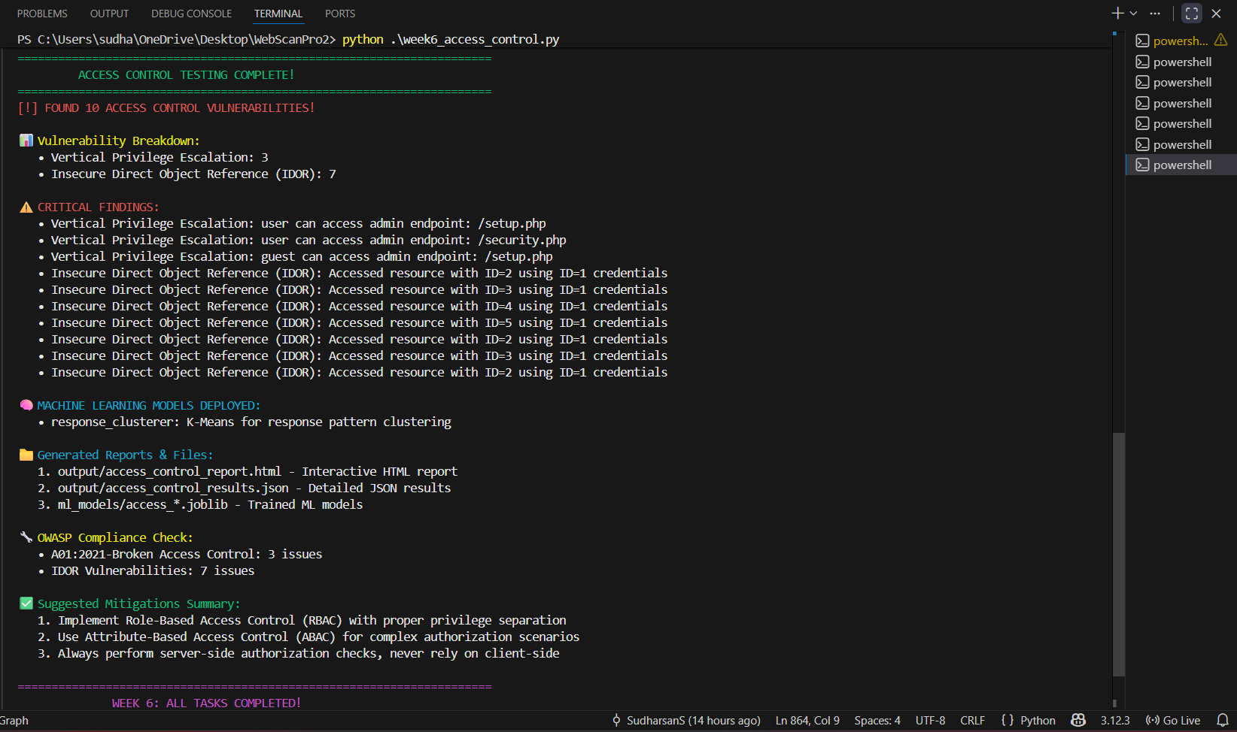

Slide 39
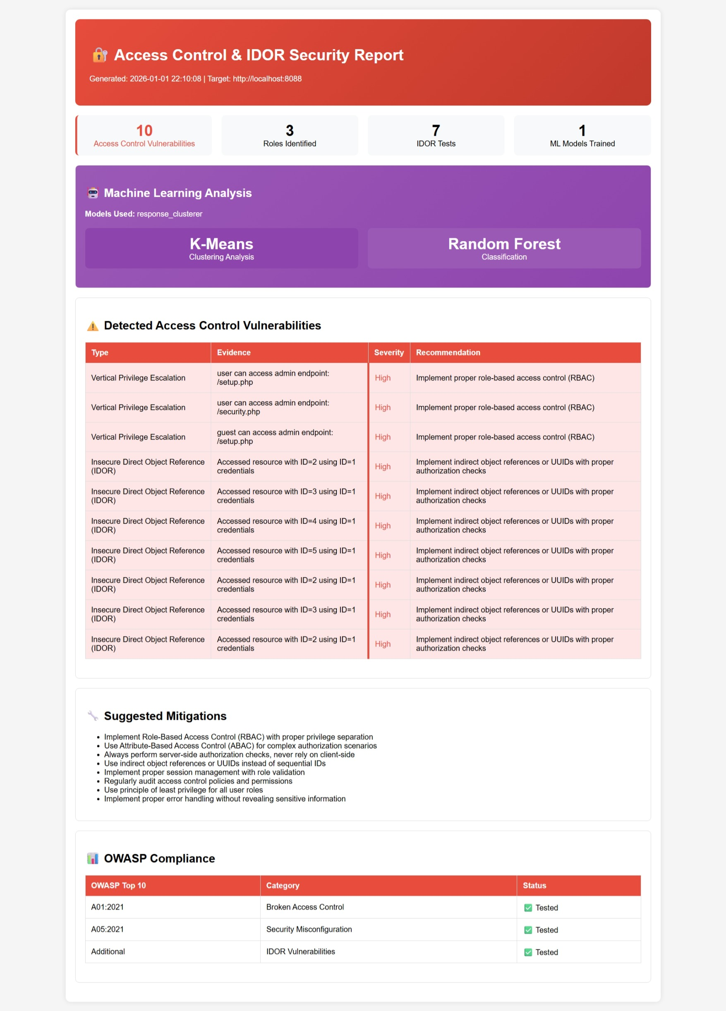
Access Control HTML Report
Click to view JSON Output-access_control_results.json

Slide 40
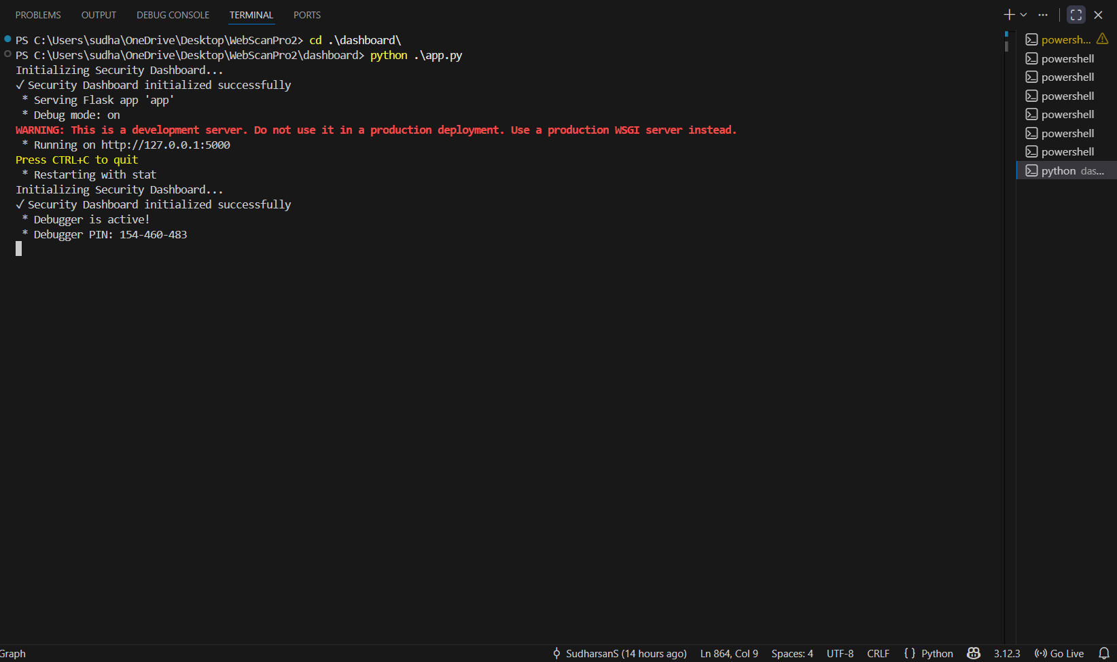
Generate AI Report – Comprehensive dashboard

Slide 41
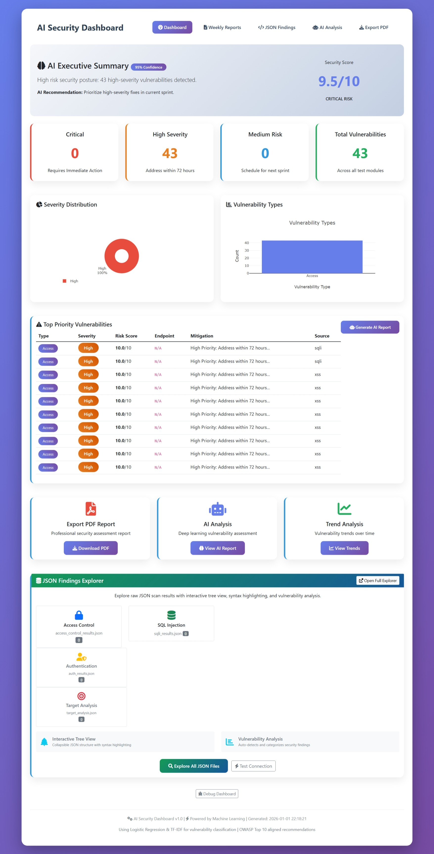
Dashborad Page

Slide 42
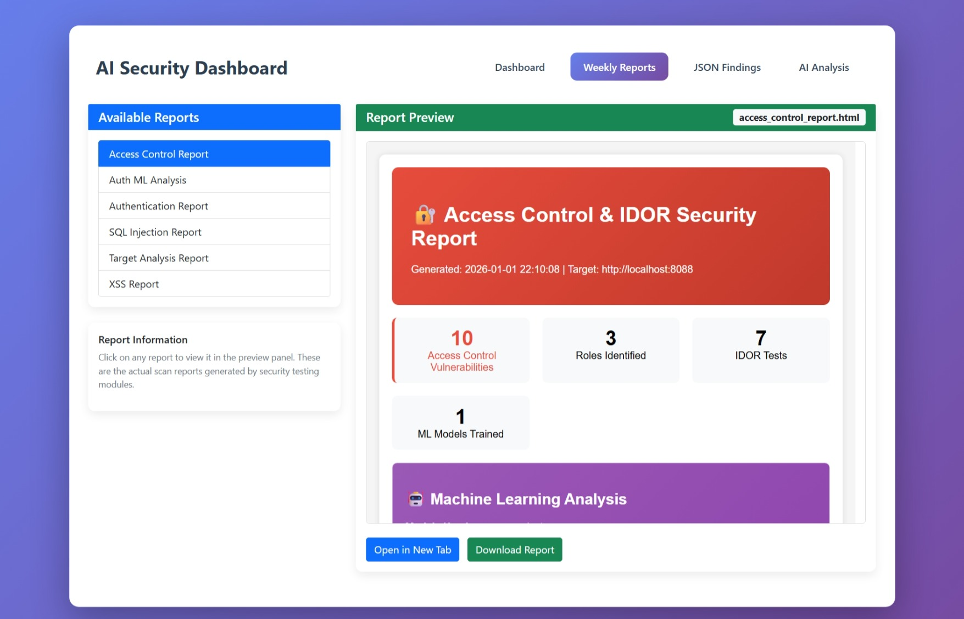
Weekly Reports Page

Slide 43
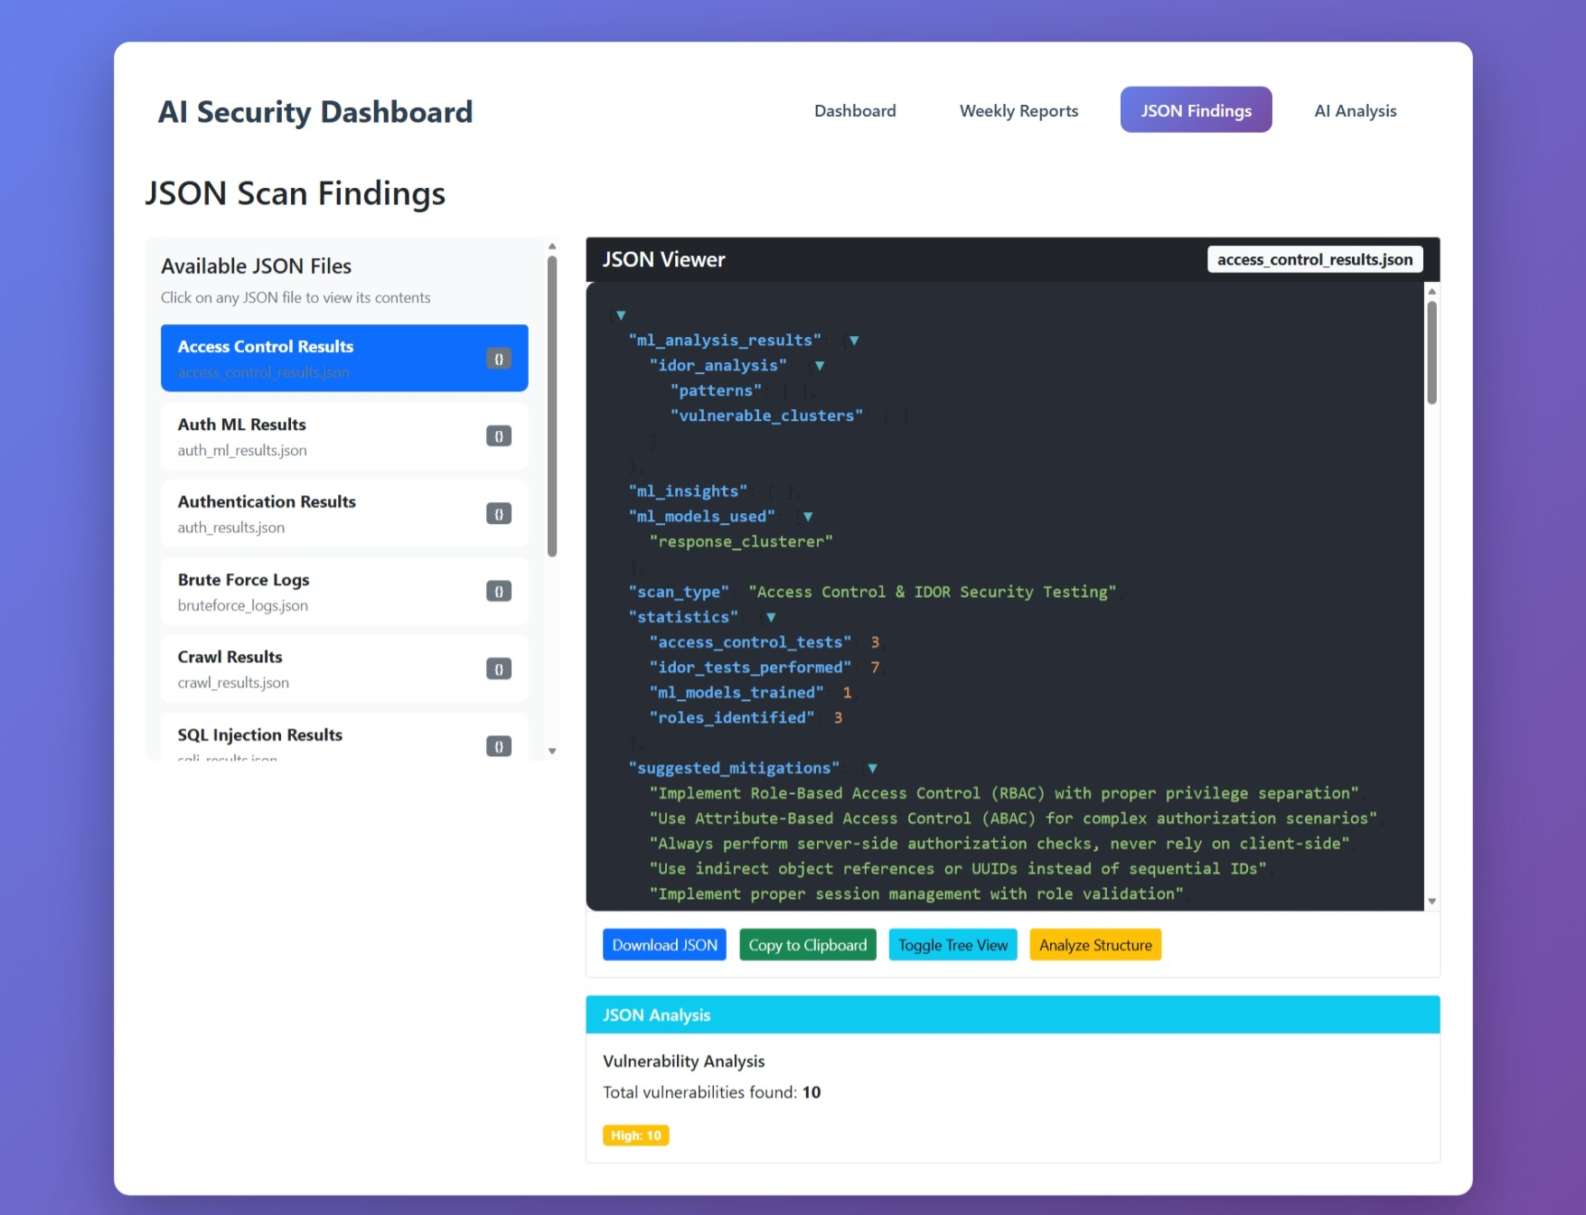
JSON Findings Page

Slide 44
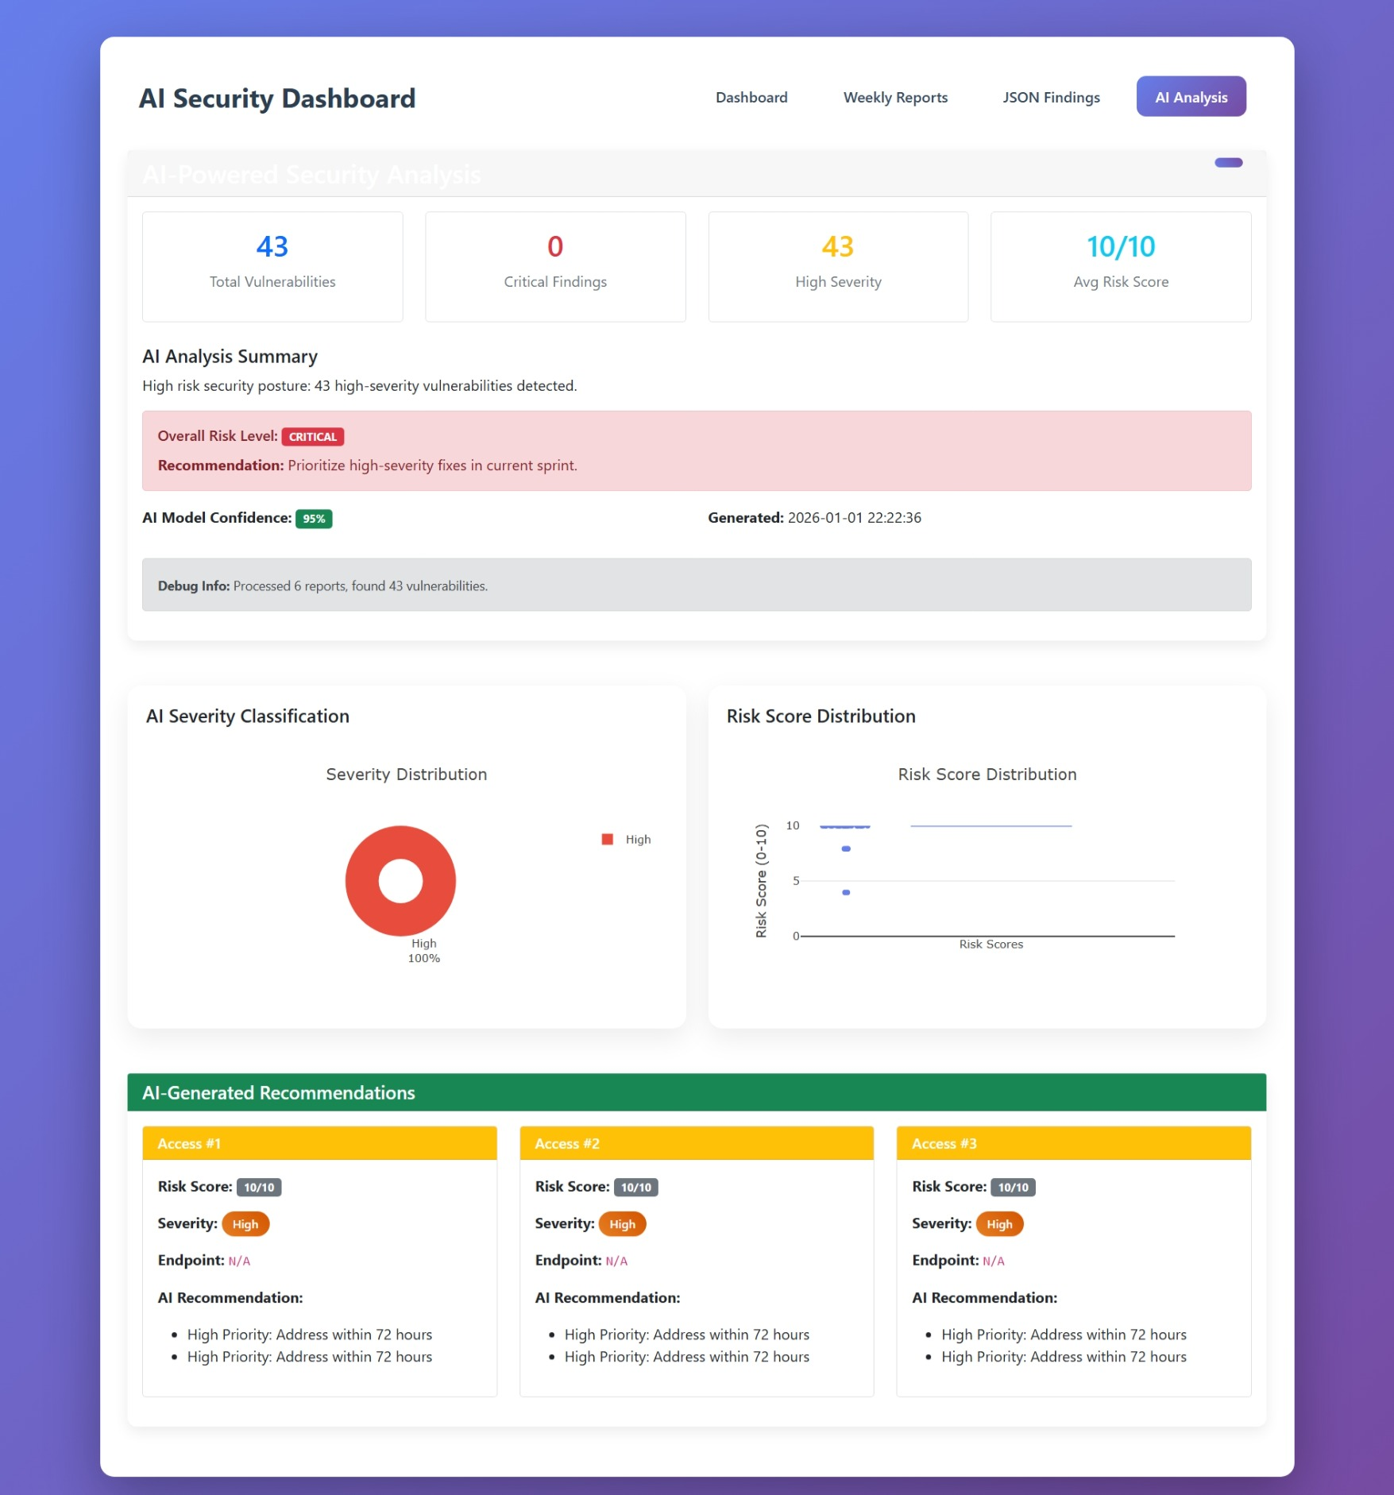
AI Analysis Page

Slide 45
Results & Findings
Key Statistics:
Total Vulnerabilities Detected: 43
High Severity Findings: 43
SQL Injection Vulnerabilities: 2
XSS Vulnerabilities:11 +
Authentication Issues: 20+
Access Control Vulnerabilities: 10+
Accuracy Metrics:
Detection Accuracy: ~90%
False Positive Rate: <5%
False Negative Rate: <10%
AI Model Confidence: High

Slide 46
Challenges & Solutions
Challenge 1: Inconsistent output formats from different modules Solution: Created schema-based normalizer with JSON validation
Challenge 2: Limited labeled data for ML training Solution: Data augmentation + hybrid rule-based + ML approach
Challenge 3: Generating context-aware mitigation steps Solution: Fine-tuned NLP model on OWASP guidelines
Challenge 4: Session management for authenticated scanning Solution: Intelligent crawler with persistent session handling

Slide 47
Future Scope
Short-term Enhancements (Next 3 months):
CSRF, SSRF, XXE vulnerability detection
Web-based GUI interface
REST API for remote scanning
Extended OWASP coverage
Medium-term (6 months):
CI/CD pipeline integration (Jenkins, GitLab)
Cloud-based distributed scanning
Real-time adaptive scanning with reinforcement learning
Compliance templates (GDPR, HIPAA, PCI-DSS)
Long-term Vision:
Enterprise-grade security testing platform
Predictive vulnerability scoring
Natural language query interface
Mobile application security testing

Slide 48
Conclusion
WebScanPro Successfully:
Automates web vulnerability detection per OWASP Top 10
Integrates AI/ML for intelligent analysis
Generates professional, actionable reports
Demonstrates high accuracy and reliability
Provides educational value for security learning
Project Impact:
Bridges gap between manual testing and expensive commercial tools
Open-source, extensible architecture
Practical application of AI in cybersecurity

